Slide 1
OFHS Senior Meeting
9/11/23
Agenda: Introductions, Senior Info, Counseling Team, College & Career Center

Slide 2
Resources: Administration
Dr. Eric C. Smith
AP over Curriculum
smithericc@pcsb.org
Julie Finley
AP over Graduation
finleyju@pcsb.org

Slide 3
Resources: Counselors, College & Career
Mrs. Nymark A-G
nymarkk@pcsb.org
Ms. Polizzi P-Z
polizzie@pcsb.org
Ms. Jackson H-O
jacksontw@pcsb.org
Ms. Long C&C
longjul@pcsb.org

Slide 4
Senior Information
OFHS Senior Site
  https://www.pcsb.org/Page/12942
District High School Education Website
  https://www.pcsb.org/Page/9515
Senior Dues: $135 (cap/gown, diploma cover, medallion, venue rental, senior breakfast/picnic)
  https://pcsb.revtrak.net/hs/osceola-high-grp/ofhs-senior-class/#/list

Slide 5



Virtual Events
this week!
6:00 PM -
Wed 9/13
Thurs 9/14

Slide 6
CCC SUPPORT
  Friday October 6th - All underclassmen will be taking the PSAT.
  Seniors can plan a college campus tour for this school day.
  Submit College Day request forms to your Alpha Clerk by October 3rd for excused absence for the 6th. Must have note from college visit when returning to school on Monday October 9th for this to be excused & not counted against exam exemptions.
  October 11th, Free In - School SAT - All Seniors are registered to take this exam. A great opportunity to improve SAT scores for college application & Bright Futures eligibility.
  Utilize FREE SAT prep from Khan Academy.
  Student can now use a combination of Volunteer Hours & Paid Work Hours for Bright Futures Scholarships, 100 hours total is required.

Slide 7
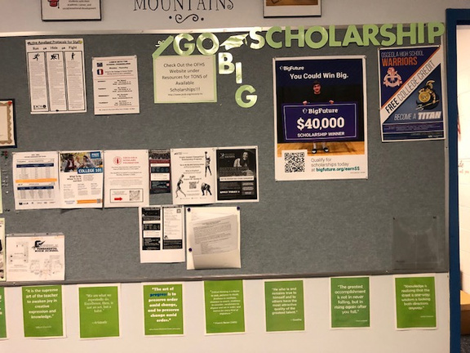
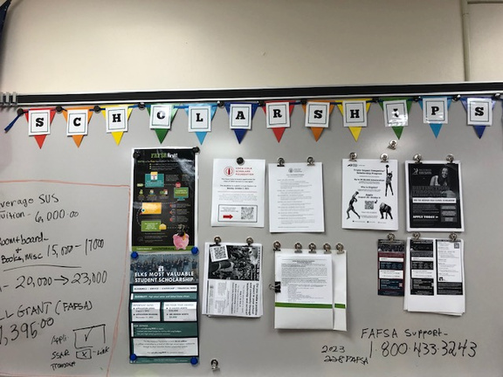
CCC SUPPORT
  October kicks off “FUND FRIDAYS” in the CCC!
  Stop by to complete the FFAA, takes about 10 minutes & requires student social security number.
  Create your FSA ID in preparation for the Dec. FAFSA application opening, also requires Social Security number.
  Always check the Scholarship Board in the Guidance Office or CCC for additional scholarship applications.

Slide 8
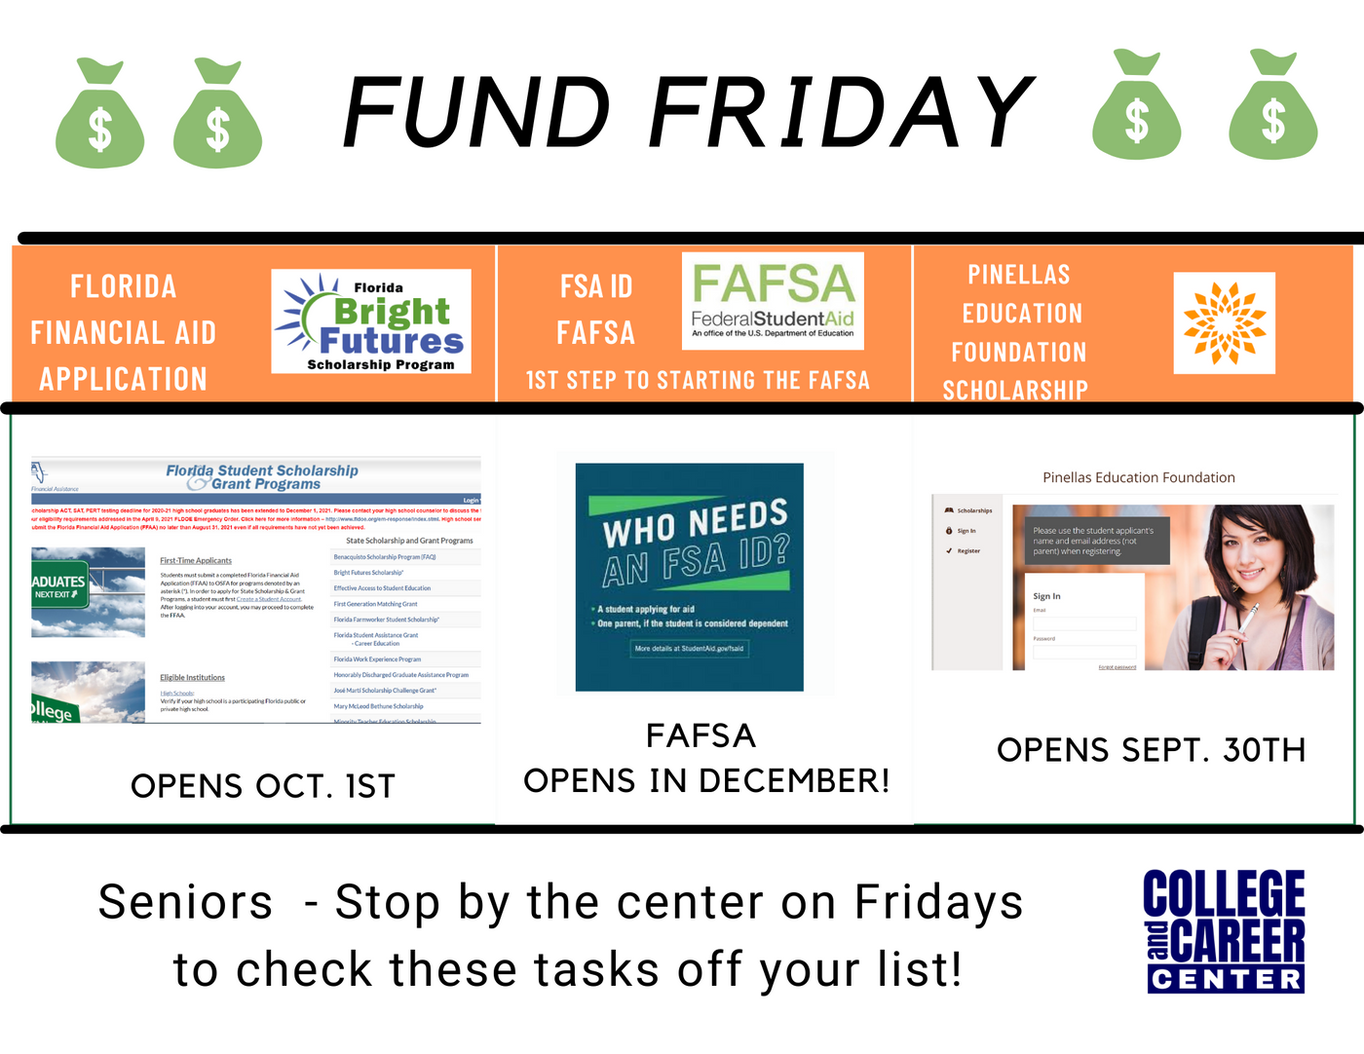
PARENTS -
COLLEGE APPLICATION SEASON IS HERE!
Ask your Senior to share
their application timeline & tasks.
Choose a day of the week to check in with them regularly to see
how they are doing.

